Slide 1
Computer Organization
TOPIC 2.0 – Computer organization
TOPIC 2
2.1.1 – 2.1.4: Computer Organization

Slide 2

REVIEW REVIEW REVIEW REVIEW REVIEW REVIEW
THE WARM-UP QUESTION
Recall the diagrams for inserting and deleting data from a linked list
Draw a representation of one of these two actions

Slide 3
REVIEW REVIEW REVIEW REVIEW REVIEW REVIEW
THE WARM-UP ANSWER
Recall the diagrams for inserting and deleting data from a linked list
Draw a representation of one of these two actions

Slide 4
TOPIC 2.1.1 – CPU
System model
You may recall our basic system model from Topic 4
Here, we’ve added storage as something the process can access
Input (Data)
Process
Output (Information)
Input (Data)
Storage

Slide 5
TOPIC 2.1.1 – CPU
System model
Data processed by a computer system in the ‘process’ phase of the model is processed in the CPU
Input (Data)
Process
Output (Information)
Input (Data)
Storage

Slide 6
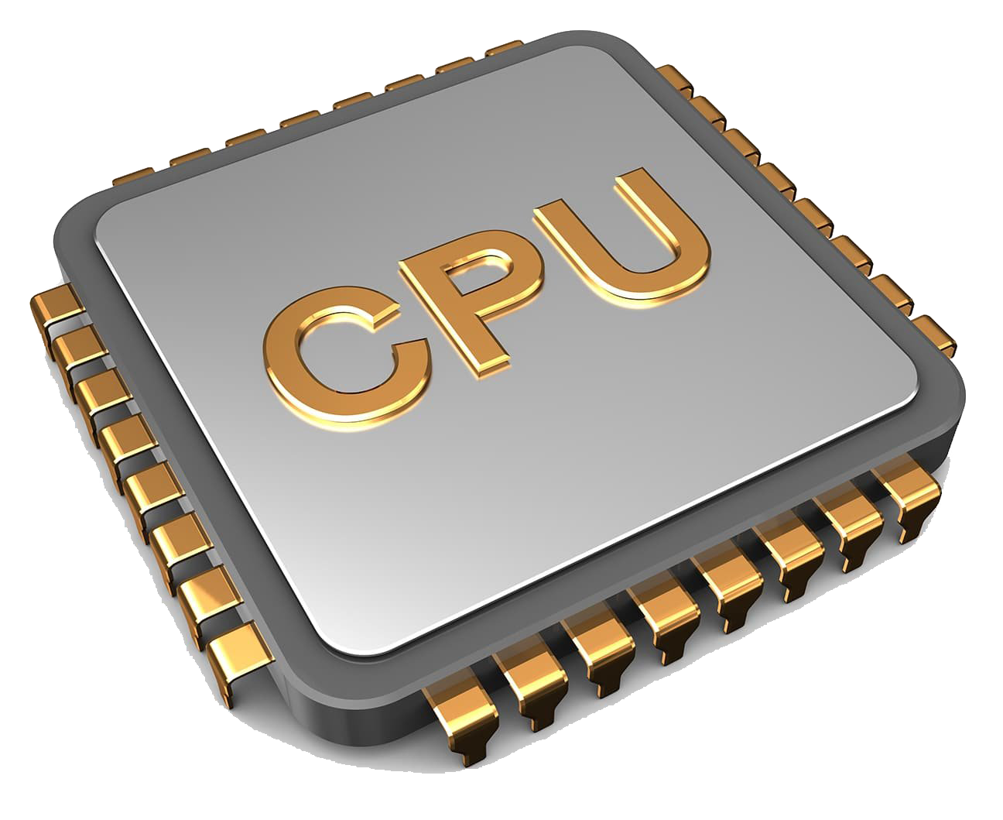
TOPIC 2.1.1 – CPU
THE CPU
The CPU is short for Central Processing Unit
CPU is a hardware component that can do:
Basic arithmetic
Logical operations
Input/output operations
The CPU is the brain of the computer, and processes data very quickly by following instructions
Often referred to as a computer’s processor or chip
CPU can only get data through input or primary memory of system

Slide 7
TOPIC 2.1.1 – CPU
CPU Control unit (CU)
The CPU Control Unit operates the CPU
It retrieves instructions from primary memory and what order to do the instructions in
Think of the control unit as the ‘Boss’ at the CPU

Slide 8
TOPIC 2.1.1 – CPU
CPU ARITHMETIC LOGIC UNIT (ALU)
The Arithmetic Logic Unit performs
Basic arithmetic
Logical operations (Boolean logic – and, or, not)
Input/Output operations
Control Unit provides ALU with all data that it needs to process
Control Unit also provides all steps that the ALU should do
Think of the ALU as the ‘brains’ of the operation

Slide 9
TOPIC 2.1.1 – CPU
CPU Registers
The Control Unit (CU) contains registers
Registers are small storage locations that can hold smaller data chunks, usually in 8 bit multiples
The size of the register in bytes is known as a word.
A 64-bit computer has 8 bytes per word, so an 8 byte word
Control Unit holds the Memory Address Register (MAR)
A register that stores the location in memory of instructions to be executed
Control Unit holds the Memory Data Register (MDR)
A register that stores the location in memory of variables to be used

Slide 10
TOPIC 2.1.1 – CPU
Diagram of cpu
Input (Data)
Processor (CPU)
Output (Information)
CU
ALU
MAR
MDR
Storage

Slide 11
TOPIC 2.1.1 – CPU
MAR USES
MAR holds memory addresses of data to be used by the ALU
MAR can also hold locations to store data at once the ALU has modified it
For the MAR to communicate with memory it uses the Memory Address Bus

Slide 12
TOPIC 2.1.1 – CPU
MDR USES
The MDR is closely related to the MAR, except it holds the actual data stored at the address in the MAR
After ALU does it’s calculation, the result is directly stored into the MDR, and data is then copied into RAM at the address in the MAR
Speaking of RAM…

Slide 13
TOPIC 2.1.2 – RAM AND ROM
PRIMARY MEMORY
Primary Memory is the only storage accessible by the CPU
Primary memory may hold both data and instructions that are running on the computer as binary “machine” code
There are two types of primary memory
Randomly Accessed Memory (RAM)
Read Only Memory (ROM)

Slide 14
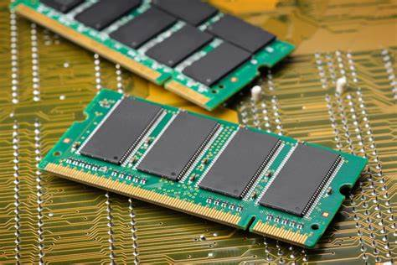
TOPIC 2.1.2 – RAM AND ROM
Random access memory
RAM is general purpose storage, meaning data can be overwritten
Whenever power is lost, the data in RAM is lost
This means the memory is volatile
Most RAM is the cheaper but slower DRAM (Dynamic RAM)
More info to come about the faster SRAM

Slide 15
TOPIC 2.1.2 – RAM AND ROM
READ ONLY memory
ROM is used to store instructions and data and can’t be overwritten
Instructions cannot be changed, even if power is lost
Non-volatile memory
ROM is used to store programs and instructions that don’t need to be changed (start up instructions of an operating system)

Slide 16
TOPIC 2.1.3 – CACHE MEMoRY
CACHE MEMORY
Cache Memory holds information in SRAM (Static RAM)
It is quite expensive but much faster, so small amounts are used to store the most frequently accessed information
This memory is stored close to the CPU
When the CPU needs data, it checks if that information is in the cache first
If it is, it gets the information from there (a cache ‘hit’)
Else, it goes to RAM to find it (a cache ‘miss’)

Slide 17
TOPIC 2.1.3 – CACHE MEMoRY
CACHE LEVELS
L1 or Level 1 Cache is on the CPU and is faster than
L2 cache, which is still faster than RAM, and is usually on the motherboard, but is slower than L1 cache

Slide 18
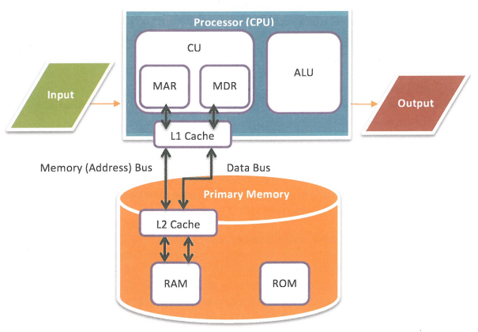
TOPIC 2.1.3 – CACHE
UPDATED DIAGRAM

Slide 19
TOPIC 2.1.4 – INSTRUCTION CYCLE
instruction cycle
At a high level, we can break down the operations of a computer into a cycle with 4 steps:
STEP 1: Fetch instruction from primary memory to control unit
CPU is responsible for getting next instructions
CPU sends memory address to memory address bus, which goes to primary memory
That instruction, once found, is copied to the data bus and sent to the control unit

Slide 20
TOPIC 2.1.4 – INSTRUCTION CYCLE
instruction cycle
STEP 2: Decode instruction in control unit
The control unit decodes the instruction to know if it needs to get any other data for the execution of the instruction
This data must then be loaded from primary memory
Addresses of these data bits are placed in MDR

Slide 21
TOPIC 2.1.4 – INSTRUCTION CYCLE
instruction cycle
STEP 3: Execute Instruction
The CPU executes the instruction using the data that was loaded and calculates the result
Depending on results, additional data may need to be fetched

Slide 22
TOPIC 2.1.4 – INSTRUCTION CYCLE
instruction cycle
STEP 4: Store result of execution and check for next instruction
CPU stores result of execution into primary memory by using memory address bus
CPU then checks for the next instruction, and the cycle repeats

Slide 23
TOPIC 2.1.4 – INSTRUCTION CYCLE
WRAP UP
Without looking back, reconstruct a diagram of the computer architecture elements we have discussed today.

Slide 24

TOPIC 2.0 – computer organization
Vocab to remember
CPU
ALU
MDR
MAR
Primary Memory
DRAM
SRAM
RAM
ROM
L1 & L2 Cache
Memory address bus

